Slide 2
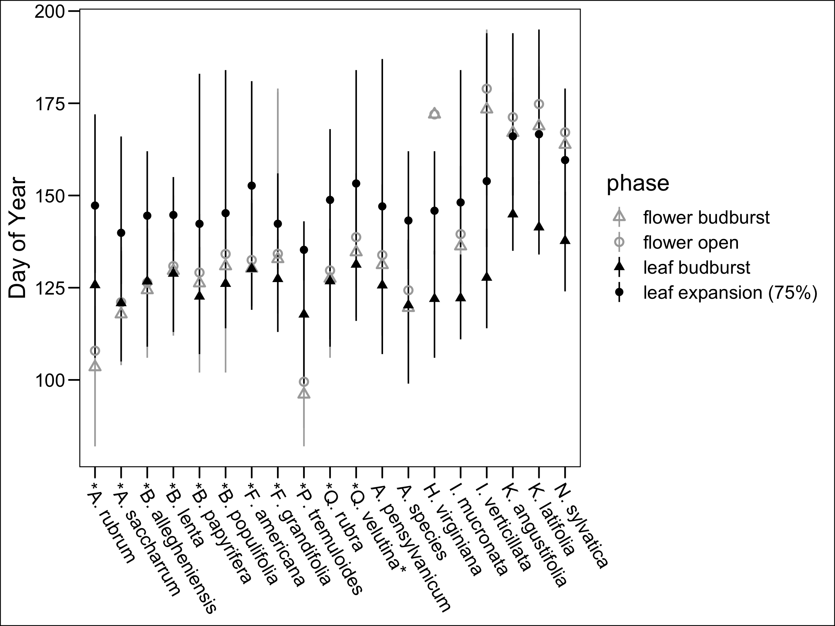
Chapter 1: Reconciling competing hypotheses regarding flower-leaf sequences in temperate forests for fundamental and global change biology
Why do some deciduous species flower before leafing?

Slide 3
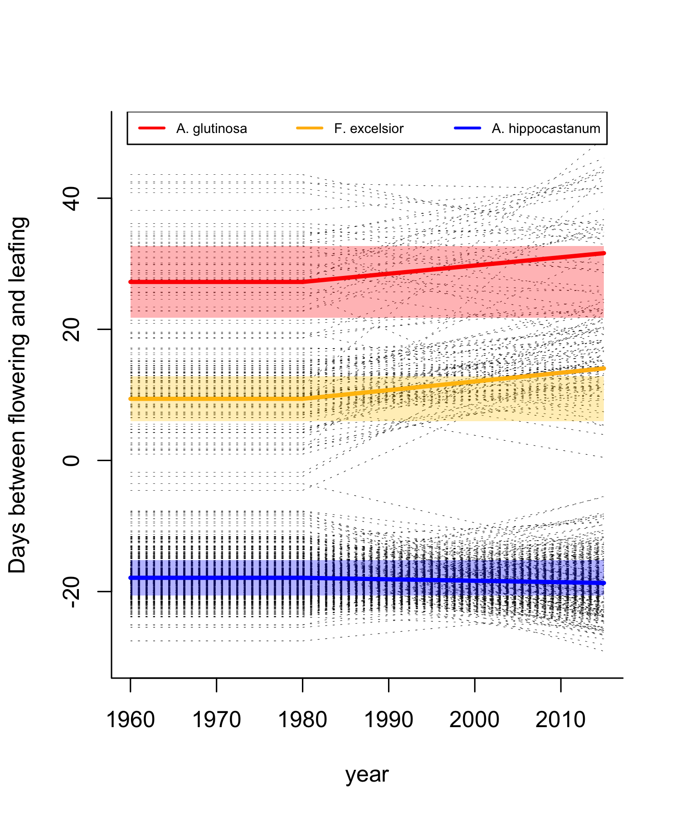
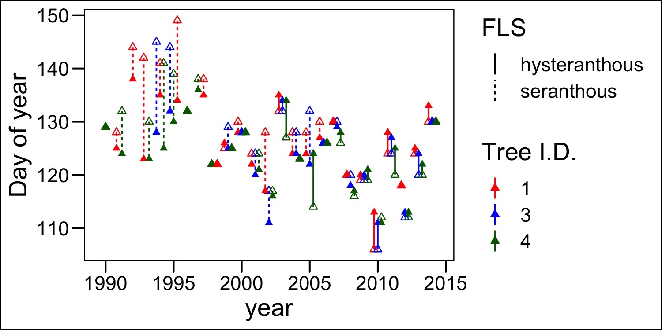
Chapter 1: Reconciling competing hypotheses regarding flower-leaf sequences in temperate forests for fundamental and global change biology

Slide 4
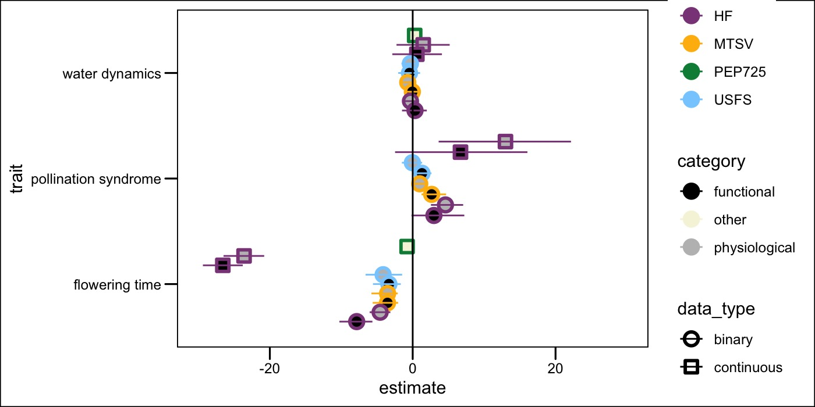
Chapter 1: Reconciling competing hypotheses regarding flower-leaf sequences in temperate forests for fundamental and global change biology

Slide 5
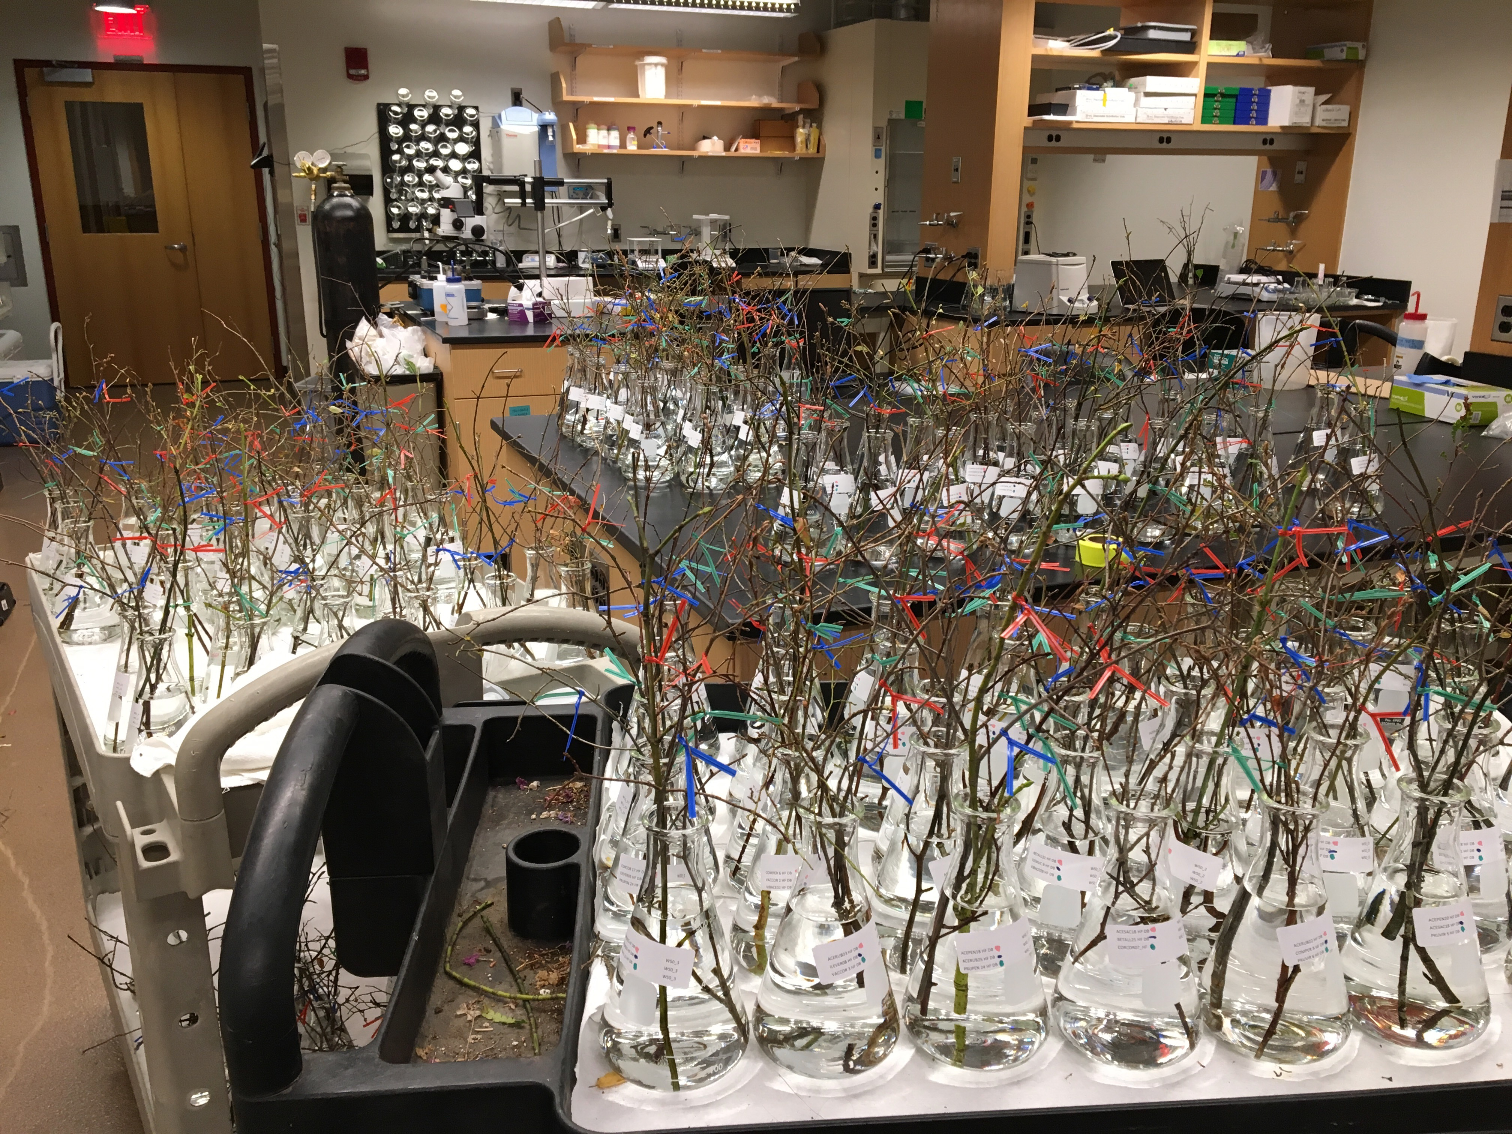
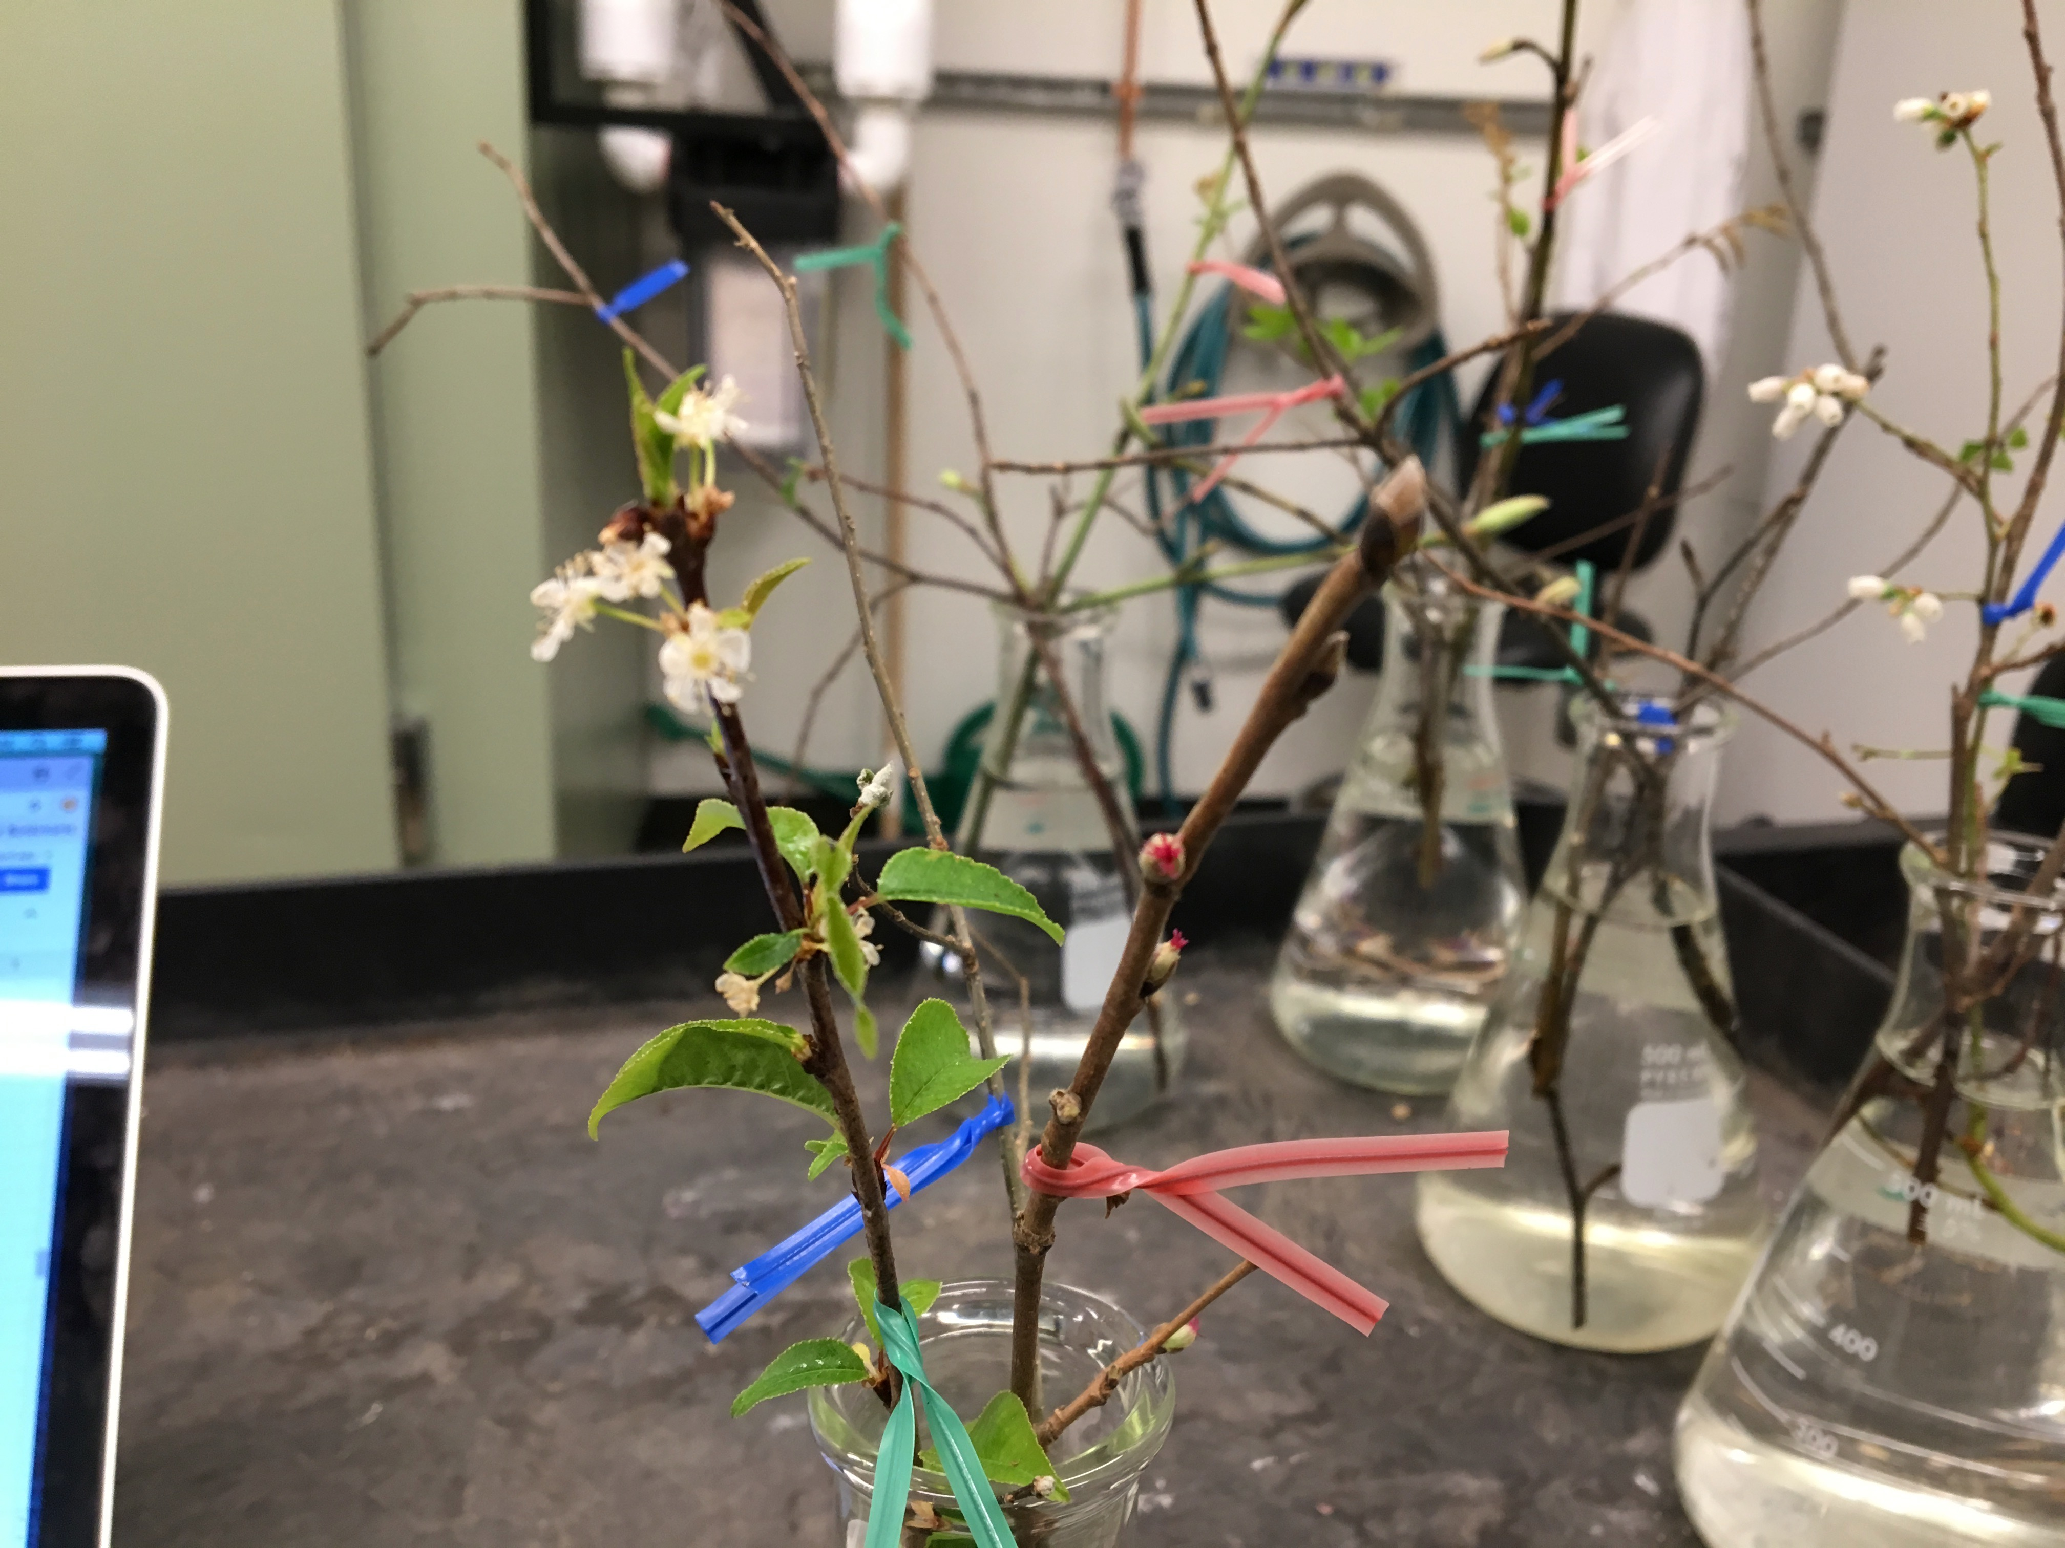
Chapter 2a: Differential sensitivity to environmental cues dictates variability in flower-leaf phenological sequences in temperate trees and shrubs

Slide 6
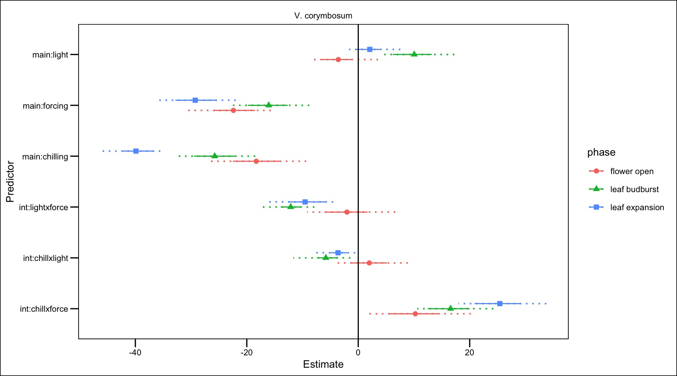
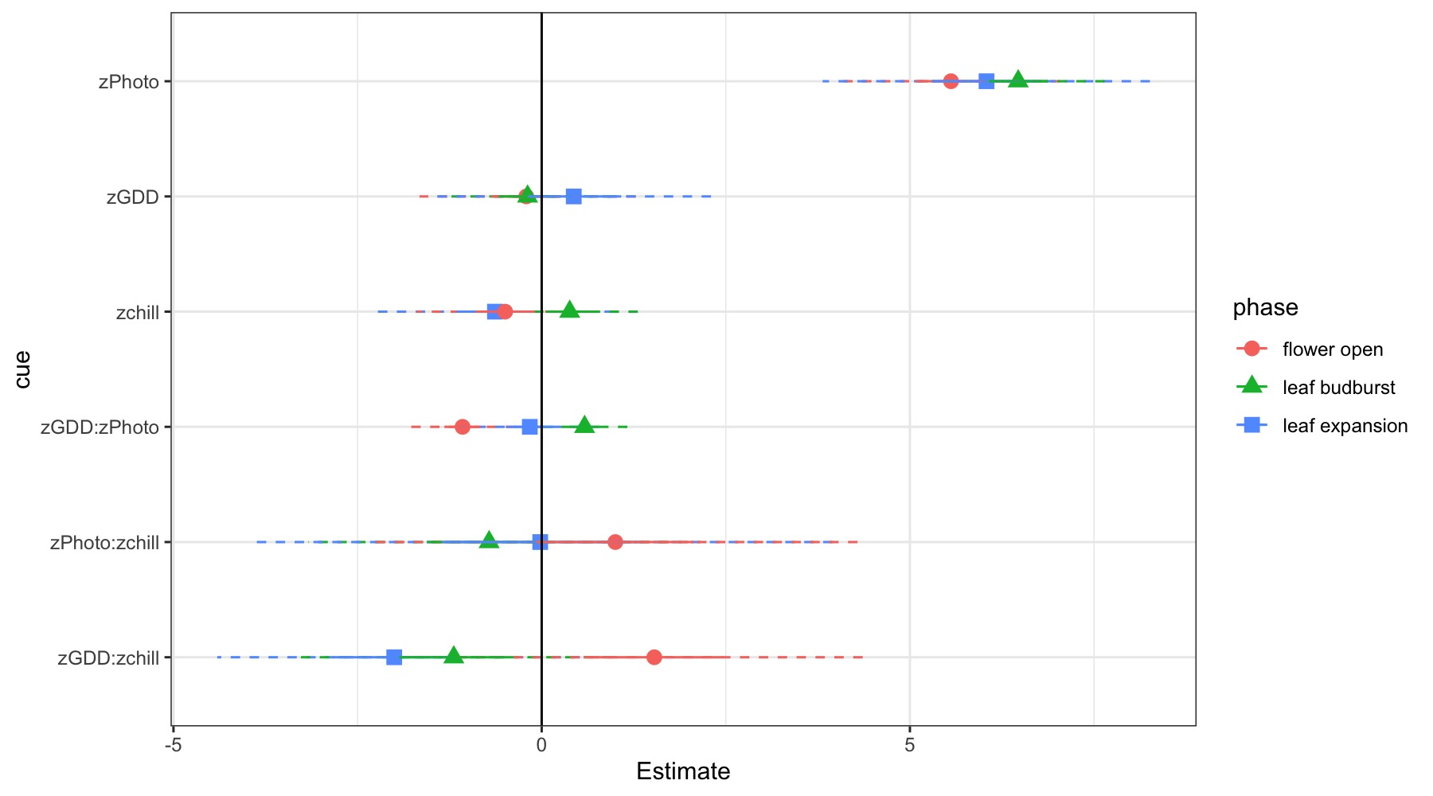
Chapter 2a: Differential sensitivity to environmental cues dictates variability in flower-leaf phenological sequences in temperate trees and shrubs
Notes:
How can I improve this comparision?
Chill Oct-1 halfway between fopn and leaf out
GDD Jan 1 and “”
Photo day length on each phase/2 ( average)
Problems: Super covaried in natures

Slide 7
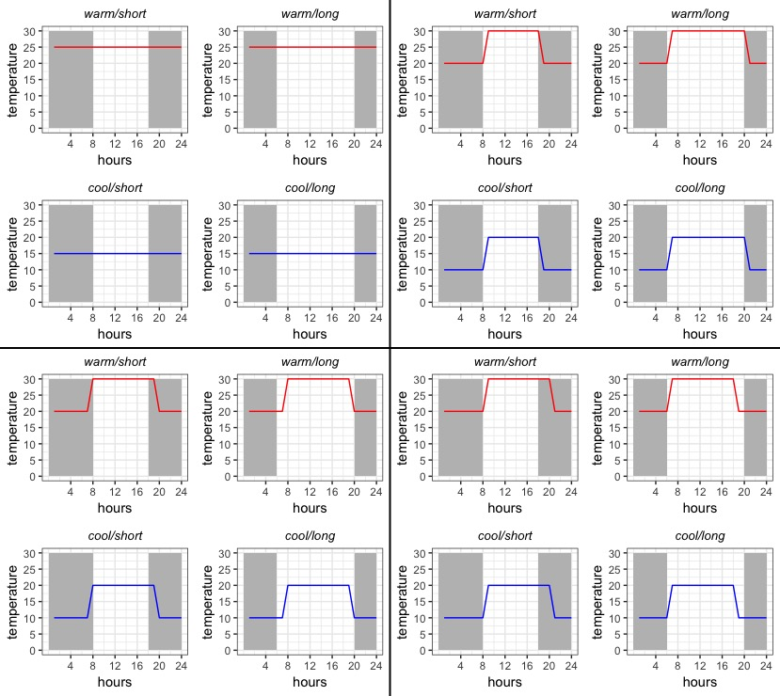
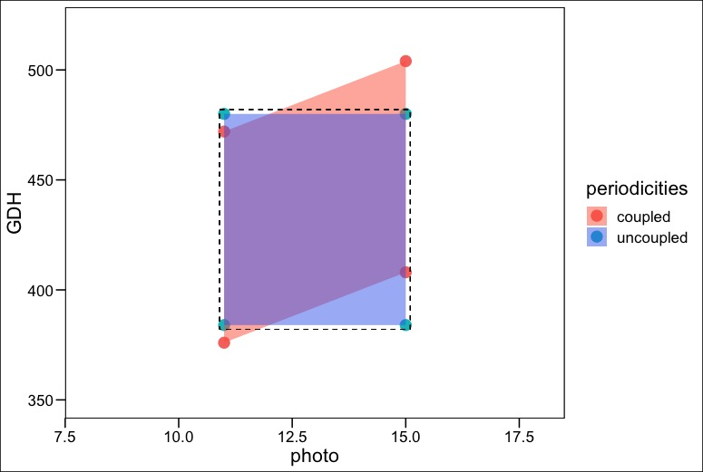
Chapter 2b: Untangling the effects of thermo- and photo- periodicity in controlled-environment experiments

Slide 8
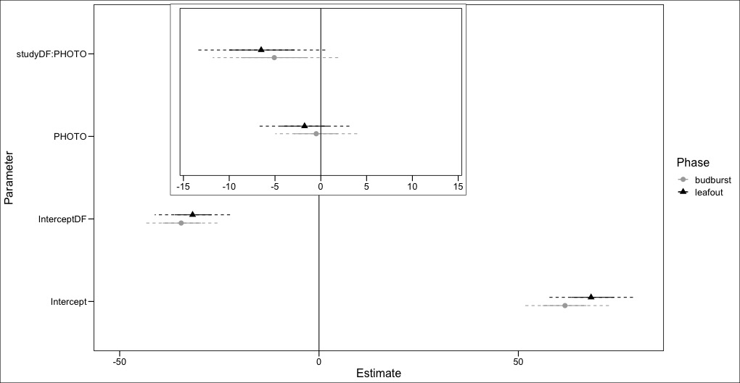
Chapter 2b: Untangling the effects of thermo- and photo- periodicity in controlled-environment experiments

Slide 9
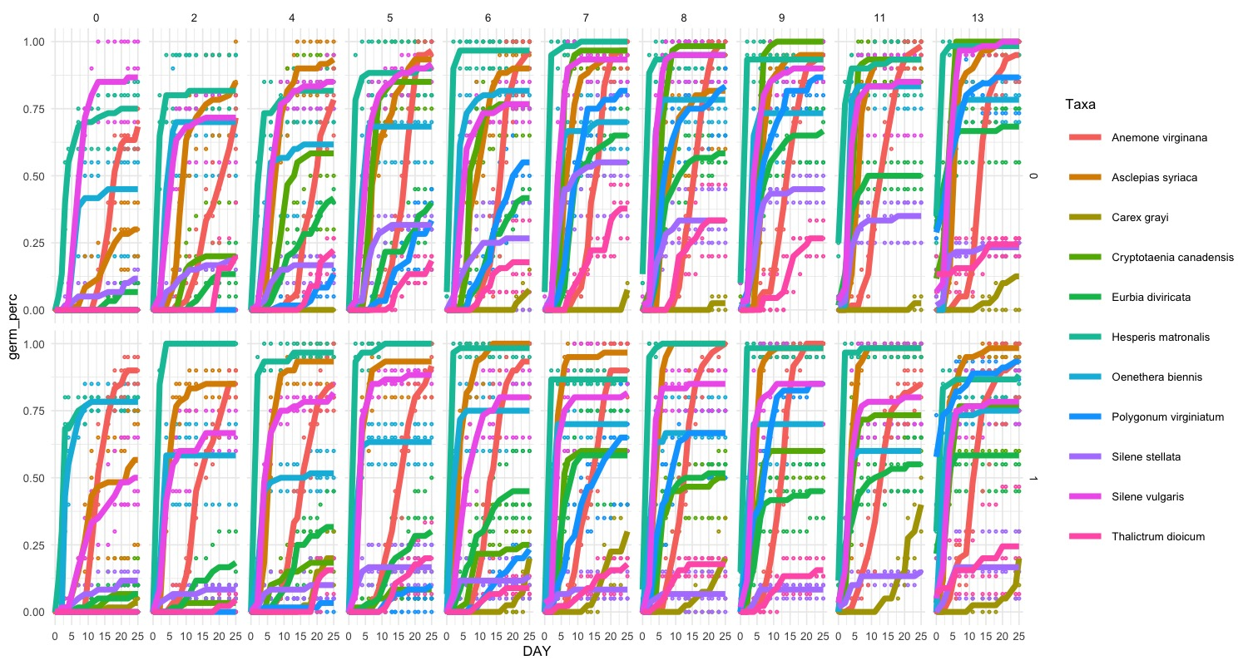
Chapter 3: Temperature variation alters germination rank of woodland herbaceous communities

